Slide 1
Distilled Water Management System

Slide 2
ABSTRACT
The "Distilled Water Management System" is a comprehensive software project that leverages the power of Java and MySQL to create an efficient and user-friendly platform for managing the production, distribution, and utilization of distilled water. The system is designed to streamline operations and enhance overall productivity, catering to the needs of different user roles, including Admin, Users, Tester, and Transporter. The project's core objective is to optimize the entire distilled water supply chain, from production to consumption, while ensuring the highest quality and adherence to regulatory standards.

Slide 3
EXISTING SYSTEM
The existing system of Distilled Water Management relies on manual processes for managing the complete order and testing procedures. As a result, it can be quite challenging for the producer to handle all aspects efficiently. The reliance on manual methods and paperwork hinders the producer's ability to have a comprehensive overview of the entire system.
In the existing system the producer faces significant challenges in managing the entire sales and testing process due to its reliance on manual procedures. The absence of an automated system makes it burdensome for the owner/producer to efficiently oversee every aspect of the existing process. With tasks predominantly paper-based and manual, the producer's ability to gain a comprehensive view of the entire system is limited.

Slide 4
In the existing system, On the customer side, the existing system necessitates complete reliance on manual processes when purchasing distilled water products. This means that customers have to engage directly with the producer or designated outlets to make their purchases. This level of dependency on manual interactions can lead to longer waiting times and potential inconveniences for the customers
Moreover, the manual nature of the existing process introduces time-consuming factors. Tasks such as record-keeping and data entry demand considerable effort and are susceptible to human errors. As a result, customers who choose to engage in direct shopping may find it challenging to access crucial information, such as price ranges and available product items, leading to a less informed shopping experience.

Slide 5
Overall, the existing manual system, while functional, presents challenges in terms of efficiency, customer experience, and management visibility. An automated and digital solution could address these issues and improve the overall distilled water management process, providing a seamless experience for both producers and consumers.

Slide 6
DISADVANTAGES OF EXISTING SYSTEM
Inefficiency: The manual nature of the existing system can lead to inefficiencies in managing sales, testing, and other processes. The reliance on paper-based documentation and manual data entry can result in delays, errors, and redundant tasks, impacting overall productivity.
Limited Visibility: Due to the absence of an integrated and automated system, the producer faces challenges in obtaining a comprehensive view of the entire water management process. This lack of real-time data and analytics hinders the ability to make well-informed decisions promptly.

Slide 7
Customer Inconvenience: Customers relying on manual processes for purchasing distilled water may encounter longer waiting times and inconvenience. The need for direct interactions with producers or retailers can lead to a less seamless and time-consuming shopping experience.
Manual Errors: Human errors in manual data entry, record-keeping, and communication can occur, potentially leading to inaccurate information and mismanagement of critical aspects of the water management system.

Slide 8
Limited Accessibility: The absence of digital platforms restricts customers' access to essential information such as product details, price ranges, and availability. This lack of transparency may hinder customer satisfaction and loyalty.
Difficulty in Scaling: As demand for distilled water grows, the existing manual system may struggle to scale up effectively. Manual processes could become overwhelmed, leading to operational challenges and potential service disruptions.

Slide 9
Compliance and Reporting Issues: Manual record-keeping may raise concerns regarding adherence to regulatory standards and reporting requirements. The absence of automated tracking and reporting mechanisms could make compliance more challenging.
Dependency on Individuals: The smooth functioning of the existing system heavily relies on the knowledge and expertise of specific individuals involved in the manual processes. Any disruptions caused by personnel changes or absences could impact the system's effectiveness.

Slide 10
Lack of Innovation: The reliance on manual methods can hinder the adoption of innovative technologies and practices that could optimize the water management process and improve overall efficiency.
Data Security Concerns: Paper-based documentation raises data security and privacy concerns, as sensitive information may be susceptible to loss, theft, or unauthorized access.

Slide 11
To address these disadvantages and improve distilled water management, the implementation of automated and digital solutions is essential. Transitioning to a more technologically advanced system can enhance efficiency, transparency, and customer satisfaction while promoting sustainable water management practices.

Slide 12
PROPOSED SYSTEM
The proposed system for Distilled Water Management is a comprehensive and innovative solution that aims to revolutionize the entire process of producing, distributing, and delivering purified water. Leveraging cutting-edge technology and automation, the proposed system addresses the limitations of the existing manual system and offers an array of functionalities to ensure efficiency, transparency, and customer satisfaction.

Slide 13
The proposed system is developed to overcome the disadvantages of the existing system and optimize the Distilled Water Management System, a modern and automated approach could be implemented. By introducing digital solutions, the sales and testing processes can be streamlined, alleviating the burden on producers and enhancing their visibility over the entire system. Additionally, automated purchasing options could empower customers, providing them with convenient access to product information and a seamless shopping experience. The integration of technology in the existing system promises to revolutionize distilled water management, making it more efficient, customer-friendly, and ultimately, ensuring a reliable supply of safe drinking water for all.

Slide 14
The proposed system streamlines the sales and testing processes through automation. Producers can easily manage and track sales, orders, and inventory in real-time using a user-friendly interface. Automated water quality testing ensures accurate and consistent results, eliminating the need for manual evaluations.
With an integrated tracking system, producers can monitor the entire water management process in real-time. From production to delivery, the system provides comprehensive insights and generates detailed reports, empowering producers to make data-driven decisions.

Slide 15
ADVANTAGES OF PROPOSED SYSTEM
Increased Efficiency: By automating various processes such as sales, testing, and inventory management, the proposed system streamlines operations, reducing manual effort and saving valuable time for producers and other stakeholders.
Enhanced Customer Experience: Through digital platforms and user-friendly interfaces, the proposed system empowers customers with convenient ordering options, access to product information, and transparent pricing, resulting in an improved and seamless shopping experience.

Slide 16
Real-Time Tracking and Monitoring: With integrated tracking and monitoring features, the proposed system enables real-time visibility into the entire water management process. Producers and transporters can track deliveries, water quality, and production status, ensuring efficient logistics and timely responses to any issues.
Data-Driven Decision Making: The system's data analytics capabilities provide valuable insights into customer behavior, demand patterns, and production efficiency. This enables producers to make informed decisions, optimize resources, and adapt to market trends effectively.

Slide 17
Improved Water Quality Management: The proposed system incorporates advanced sensors and monitoring devices to continuously assess water quality. Producers receive instant alerts for deviations, enabling prompt corrective actions and ensuring consistent high-quality distilled water.
Scalability and Flexibility: The web-based infrastructure of the proposed system allows for easy scalability, accommodating future growth and adapting to changing demands and requirements.

Slide 18
Centralized Data Management: The proposed system centralizes data storage and management, making it easier for authorized users to access essential information from any location, promoting collaboration and coordination.
Regulatory Compliance: The system's automated tracking and reporting features facilitate adherence to regulatory standards, ensuring that the production and distribution processes comply with relevant guidelines and requirements.

Slide 19
Reduced Paperwork: By reducing reliance on paper-based documentation, the proposed system contributes to environmental conservation while streamlining administrative tasks for improved productivity.
Training and Support: The system provides comprehensive training and ongoing support to all stakeholders, ensuring smooth adoption and maximizing the benefits of the proposed system.

Slide 20
In conclusion, the advantages of the proposed system for Distilled Water Management encompass enhanced efficiency, customer satisfaction, data-driven decision-making, and streamlined operations, making it a transformative solution to meet the demands of modern water management practices. The integration of advanced technology promises to elevate the distilled water industry, promoting sustainability, transparency, and accessibility for producers and consumers alike.

Slide 21
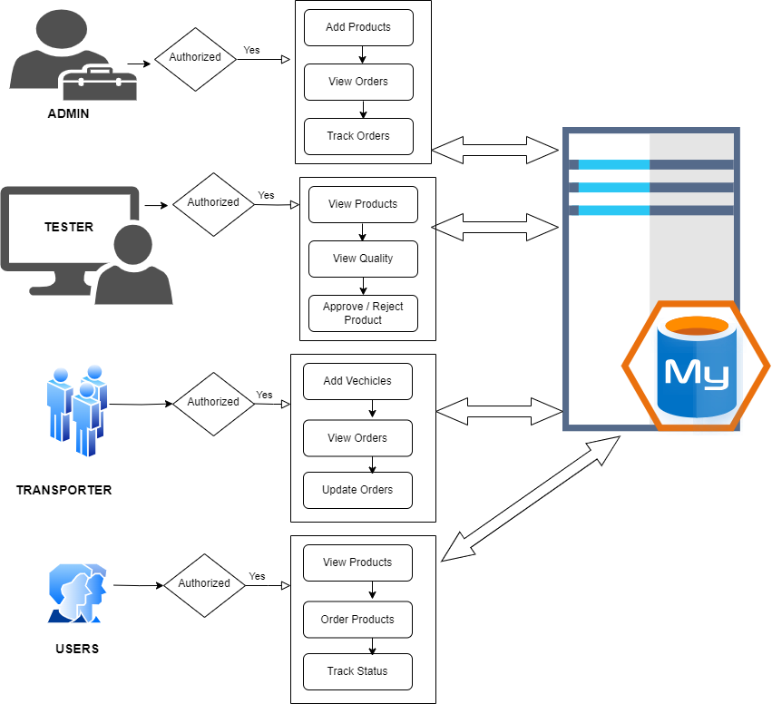
SYSTEM ARCHITECTURE

Slide 22
HARDWARE REQUIREMENTS
System : Pentium i3 Processor
Hard Disk : 500 GB.
Monitor : 15’’ LED
Input Devices : Keyboard, Mouse
Ram : 4 GB

Slide 23
SOFTWARE REQUIREMENTS
Operating system : Windows 10/11.
Coding Language : JAVA.
Frontend : JSP, HTML, CSS, JavaScript.
IDE Tool : Apache Netbeans IDE 16.
Database : MYSQL.

